Slide 1
ENSE 470, Milestone 6
Group Eh?
Nickolas Schmidt, Quinn Bast, Abdulaziz Alghamdi
March 29th 2018

Slide 2

Executive summary
Created a software approval system for HELL staff.
Technology used
MySQL, HTML, PHP, JavaScript, CSS
Recall our previous milestones in the upcoming slides:

Slide 3
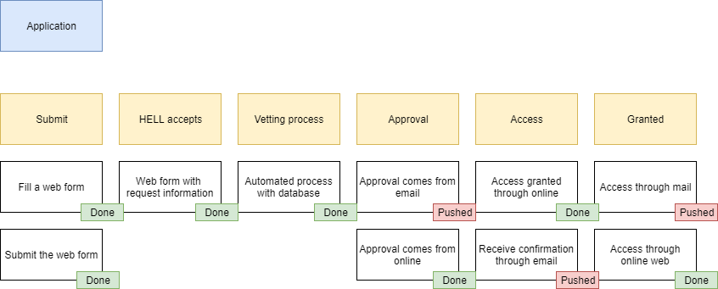
MVP Release One
Majority of the initial plan for the MVP of release one was completed.
Unfortunately, email was unable to be completed as there was not enough time to setup a mail server on our server.

Slide 4
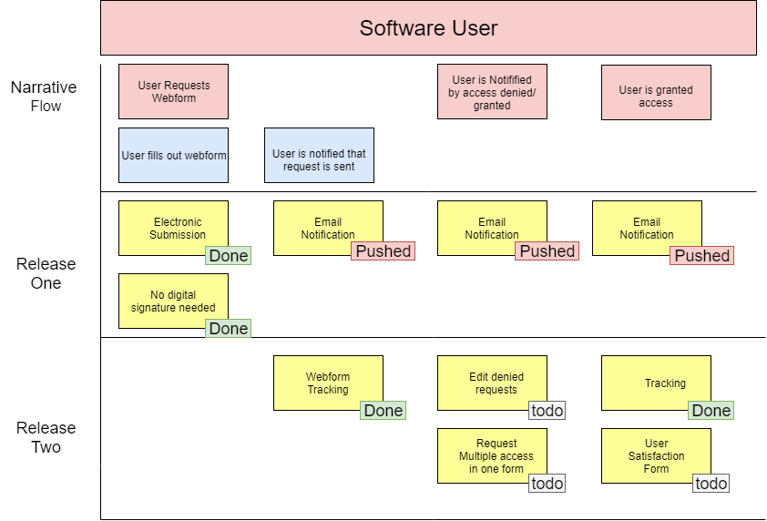
User Story Map Completion
Because of the failure to implement Email, some Release Two features were able to be implemented early.

Slide 5
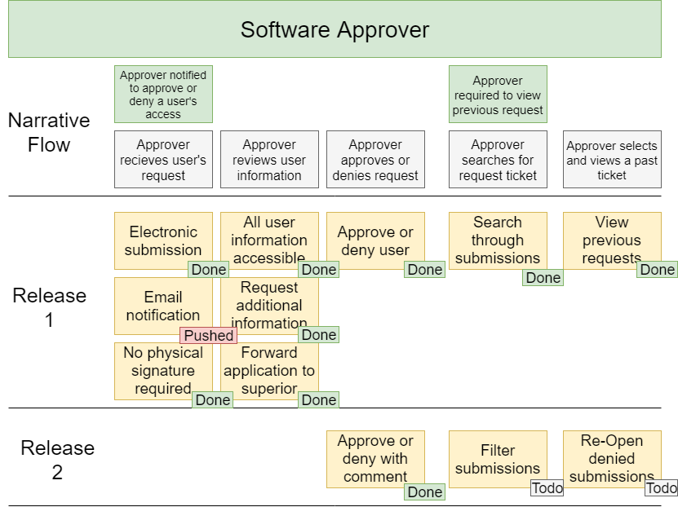
User Story Map Completion
Because of the failure to implement Email, some Release Two features were able to be implemented early.

Slide 6
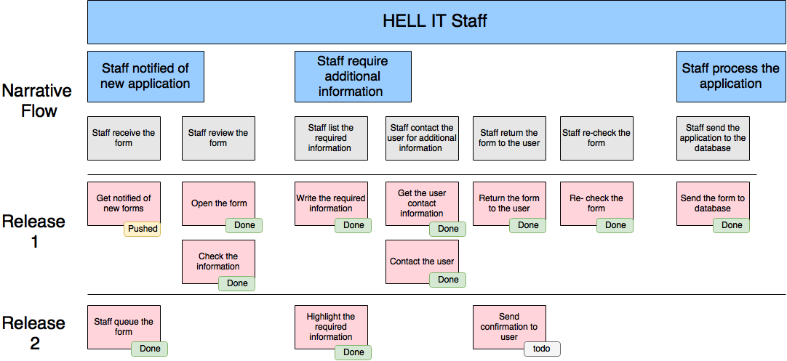
User Story Map Completion
Because of the failure to implement Email, some Release Two features were able to be implemented early.

Slide 7
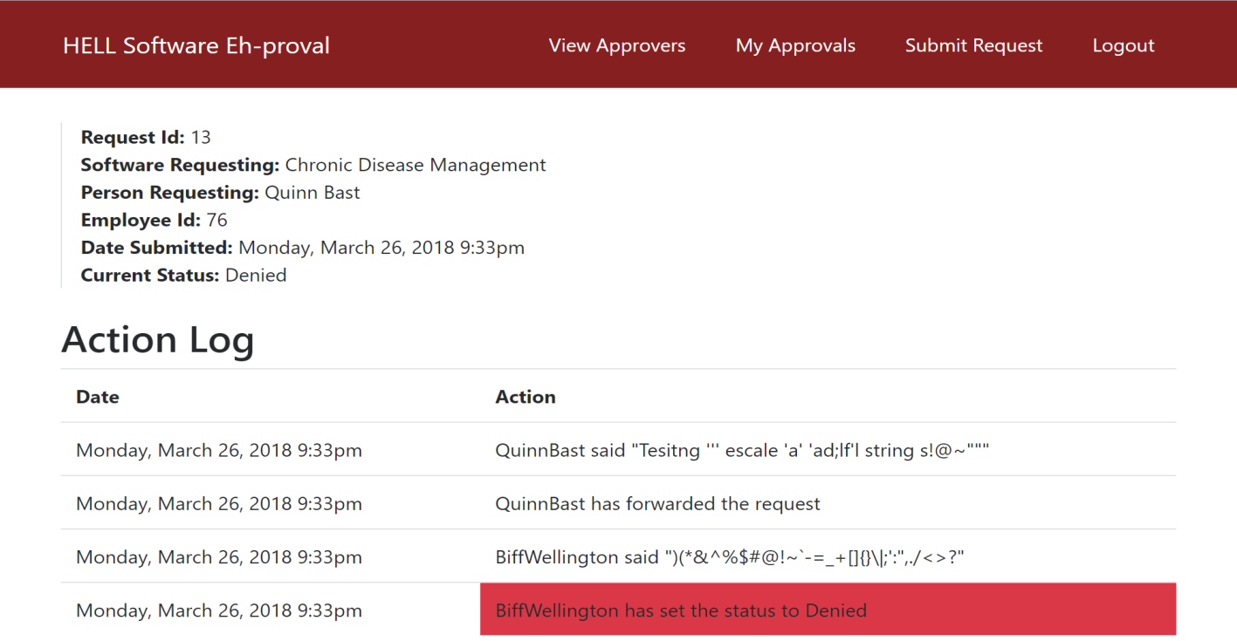
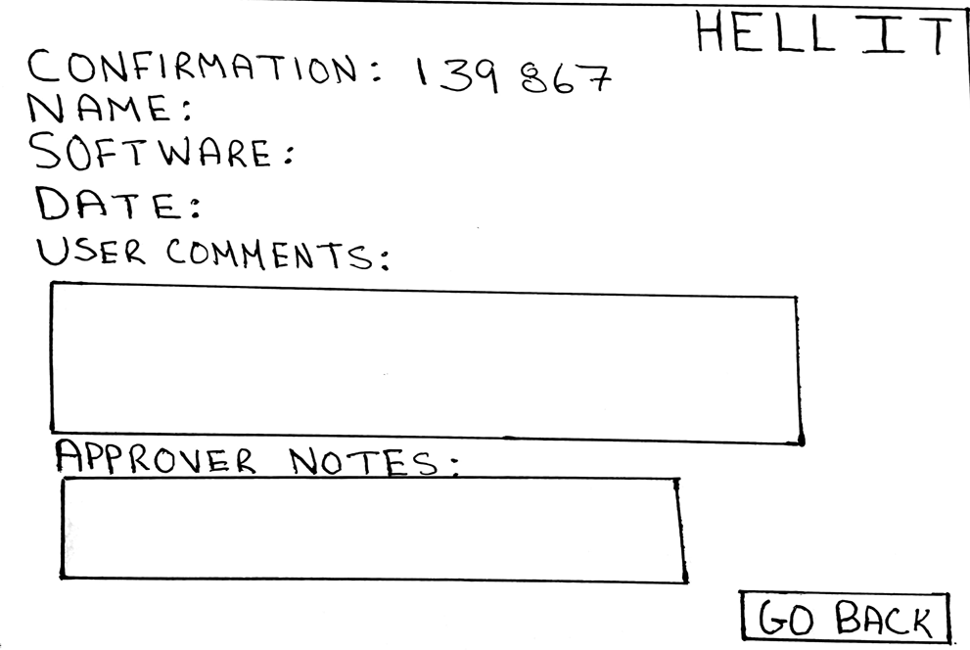
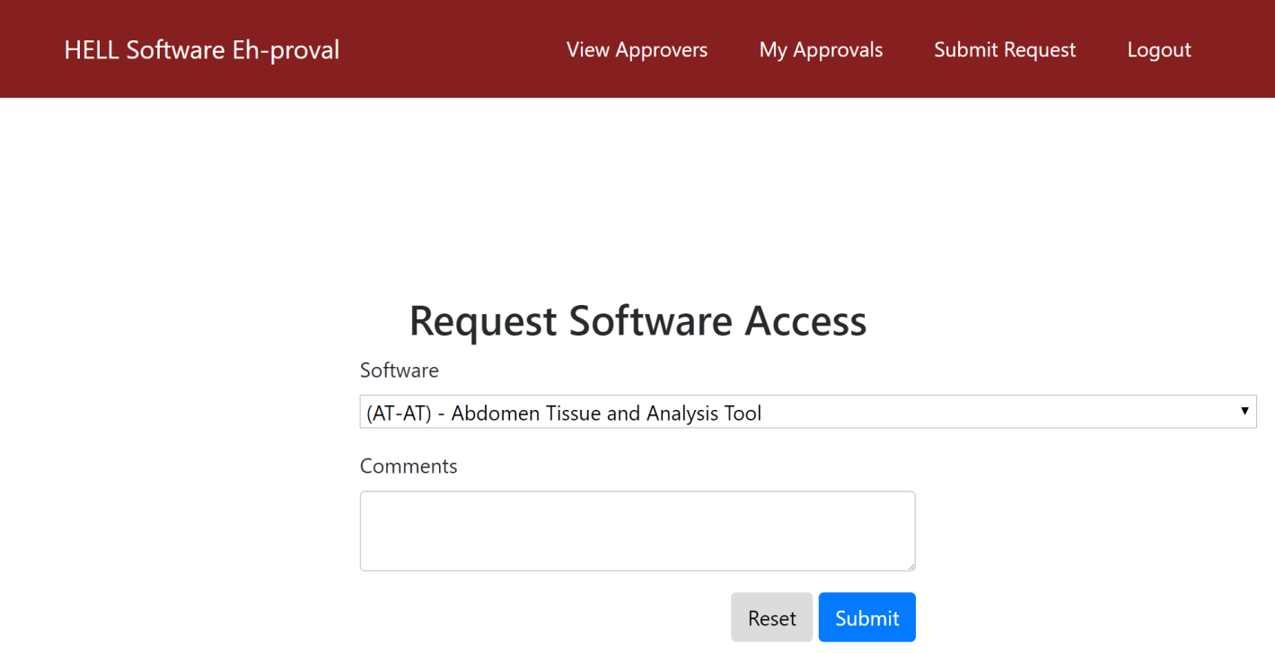
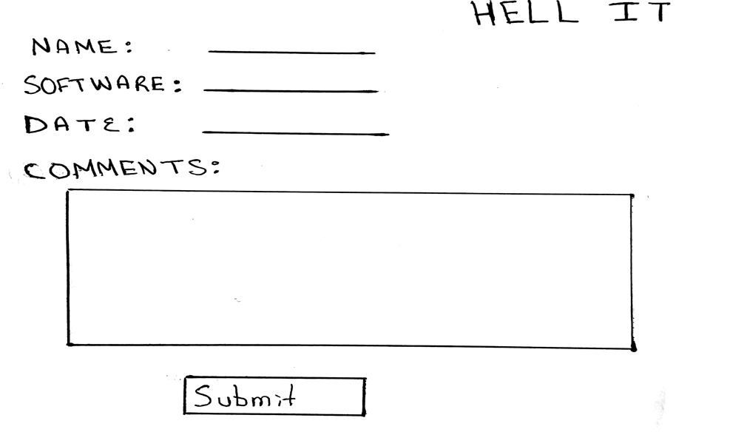
Low-Fidelity Comparison

Slide 8
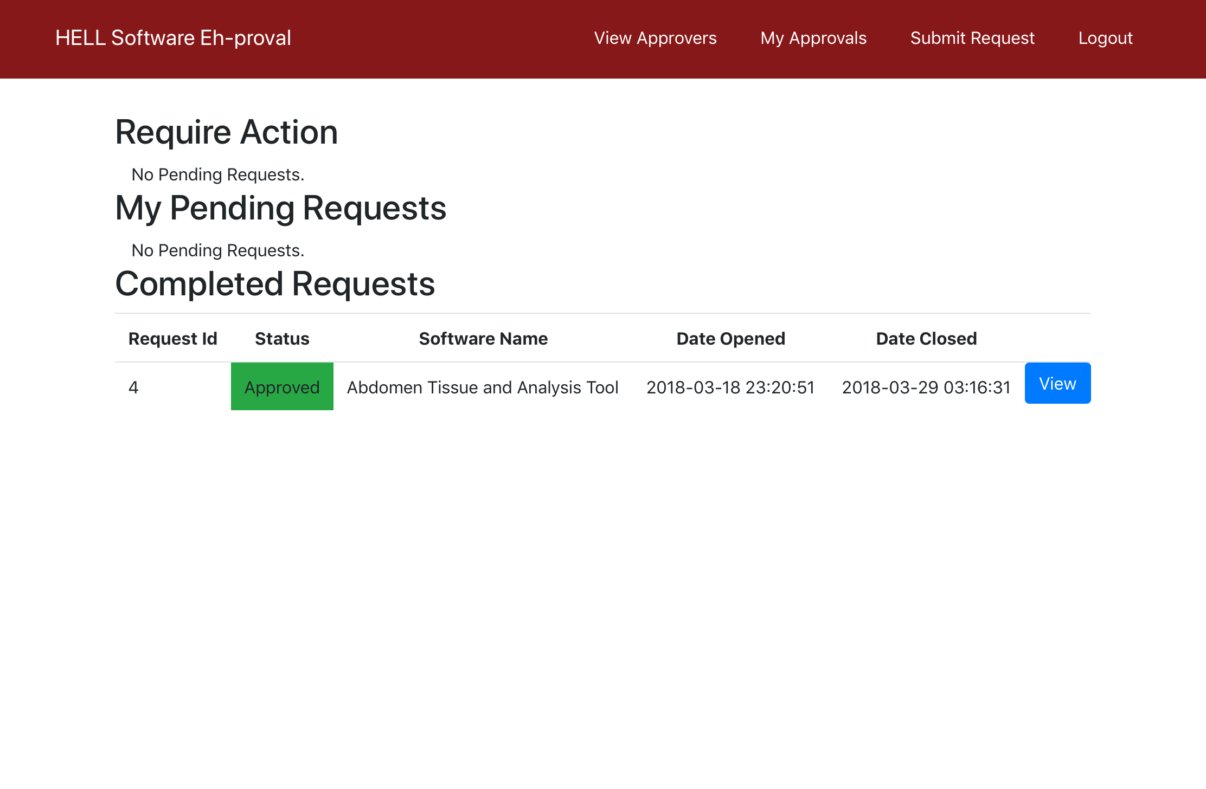
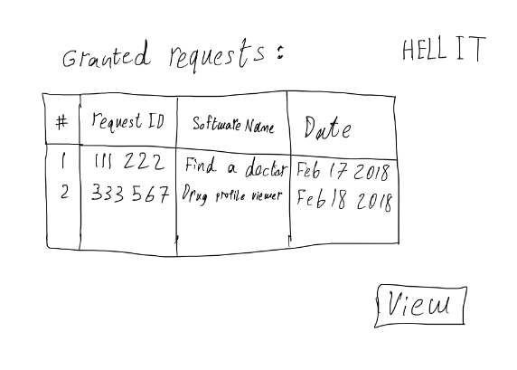
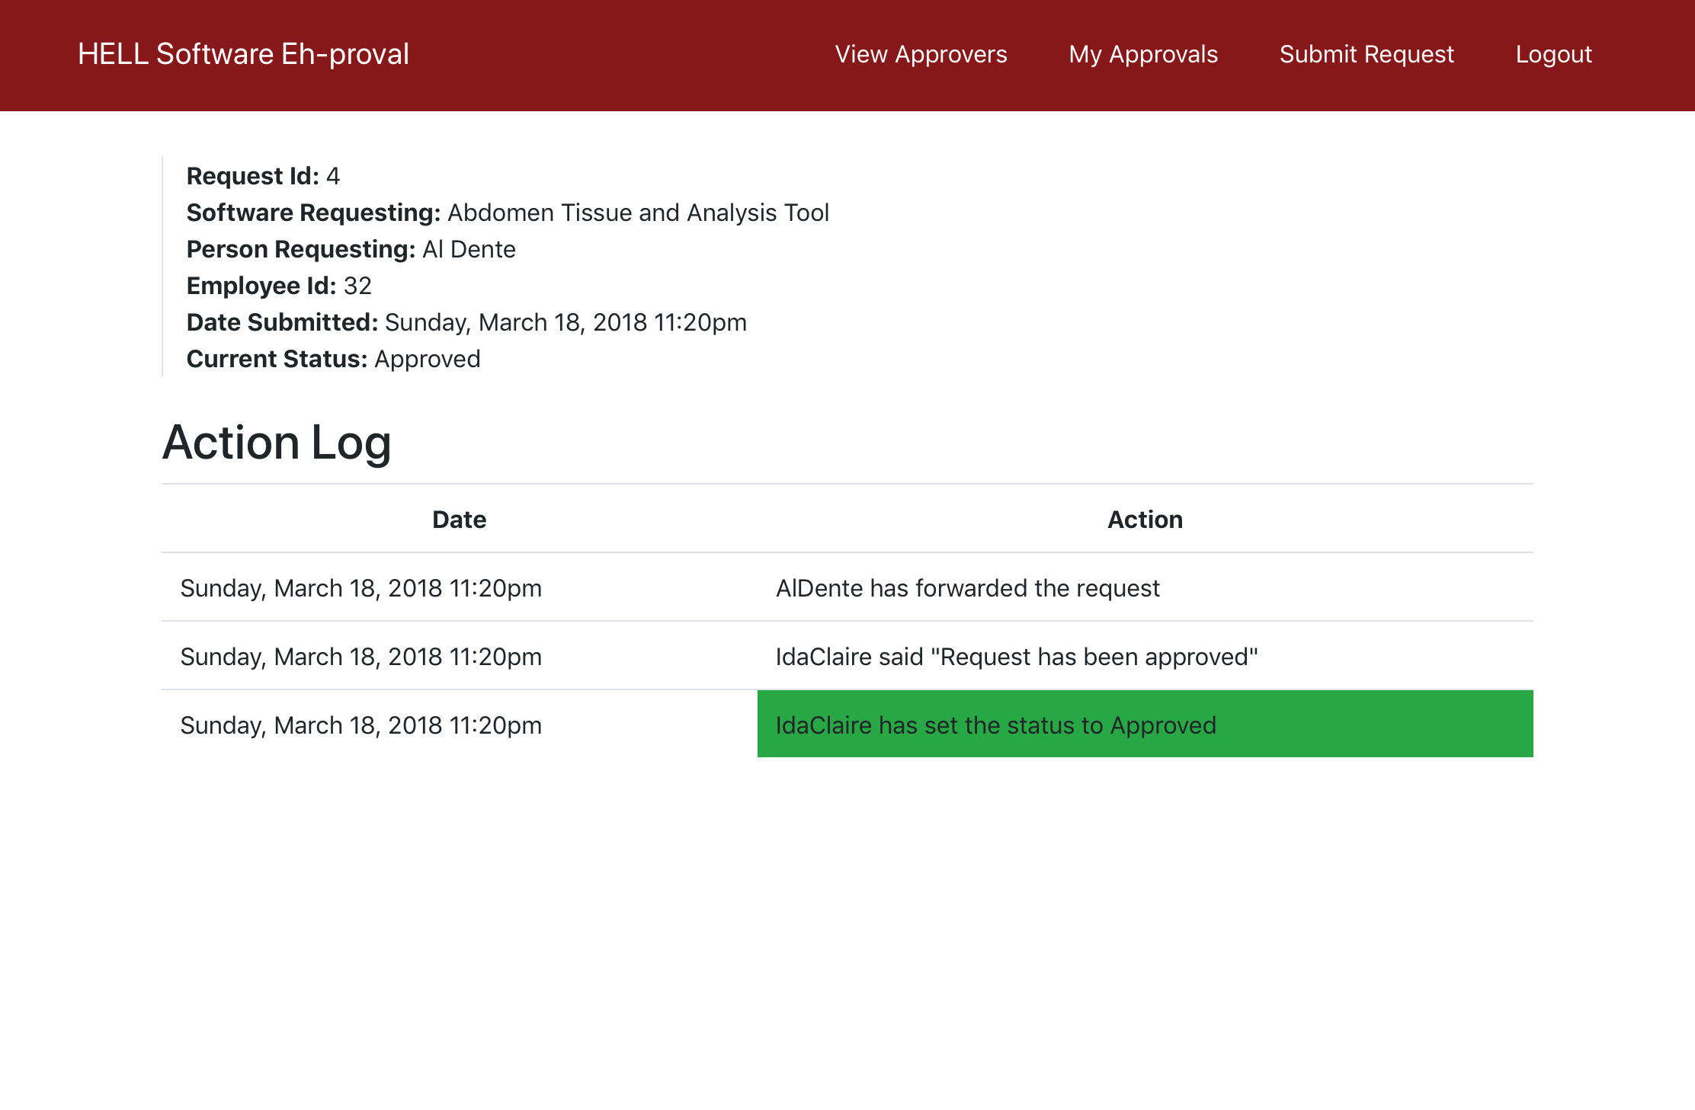
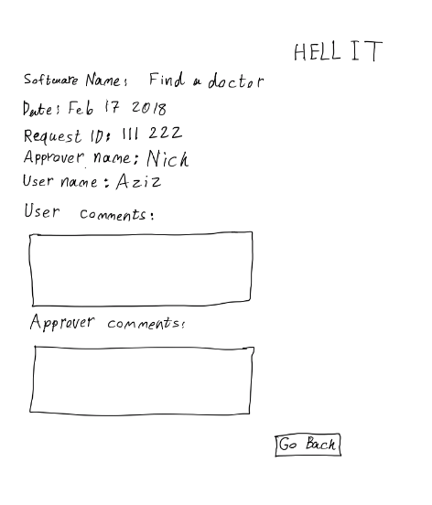
Low-Fidelity Comparison

Slide 9
Demo
http://142.165.187.167

Slide 10
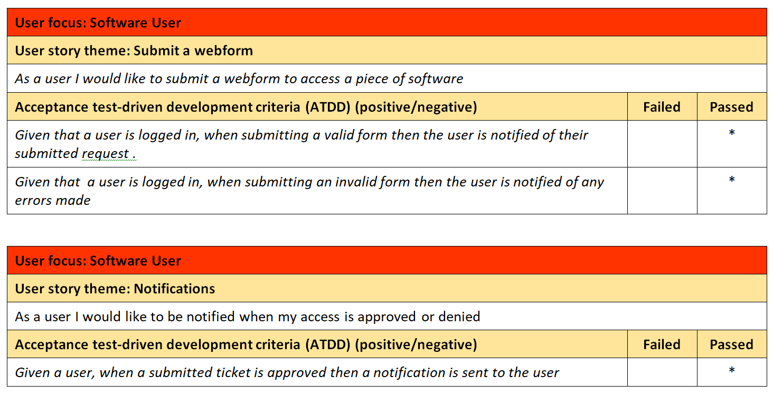
ATDD Tests

Slide 11
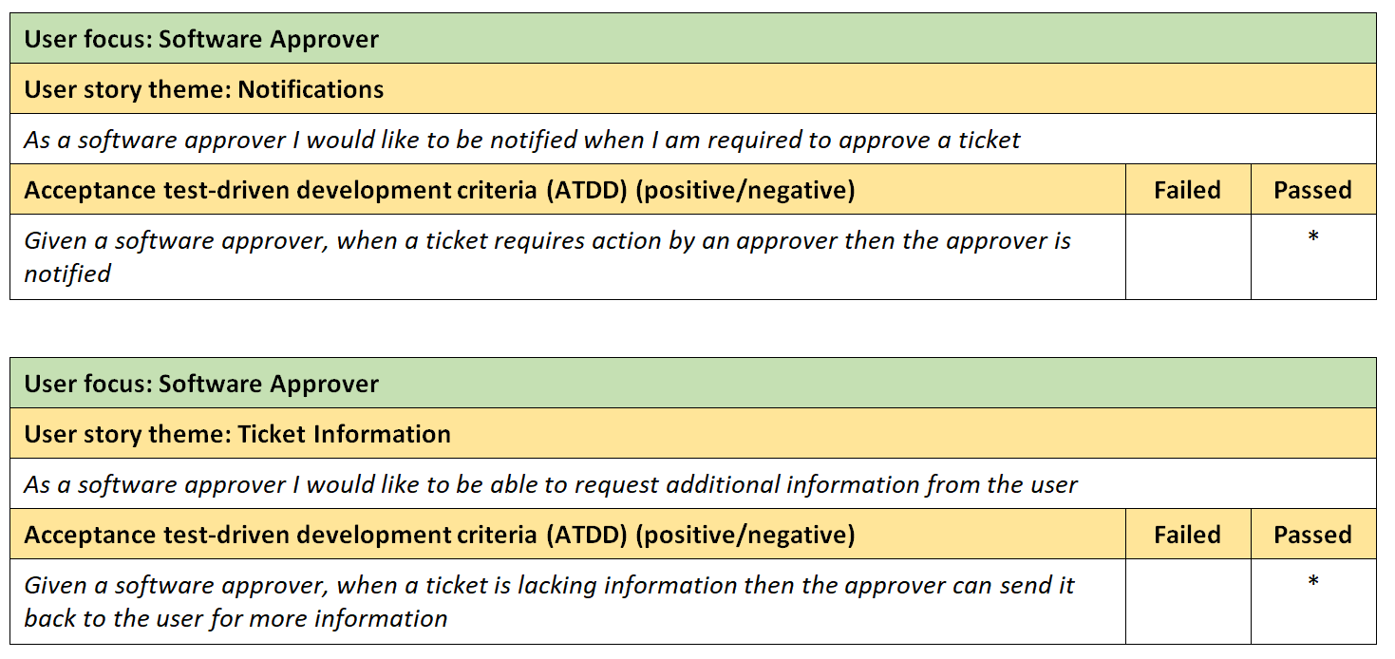
ATDD Tests

Slide 12
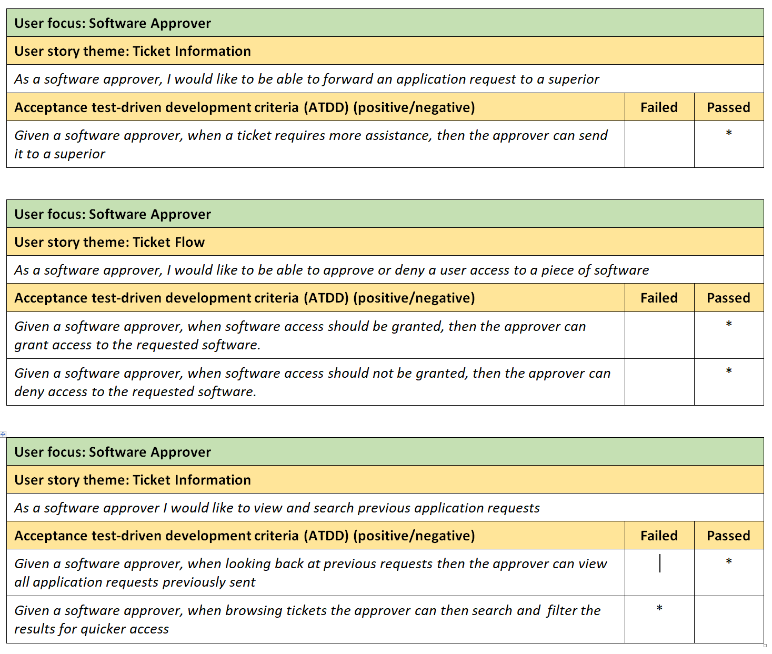
ATDD Tests

Slide 13
Design Patterns Used
Model-View-Controller
Model (Observer):
MySQL Database storing data related to the program.
Information in the view is updated when information in the database is changed.
View (Composite):
HTML, CSS and Javascript which displays the page to the user.
HTML is naturally a composite through DOM. Via the controller, the view is updated to include elements where they should be displayed to the user.
Controller (Strategy):
PHP scripts which activate when actions are taken on the page. This controls flow between pages and data being sent to the model/database.
Each button is the same, but with Strategy pattern PHP is able to interpret what buttons are pressed and control the flow of the program.

Slide 14
Design Patterns Used
Facade:
Creation of simple functions such as getLoginPage() is much easier than having to call multiple functions to load a page like loadDatabase(), loadSession(), getNav(), showLogin().
This abstracts the information away and makes page generation easier for the controller.

Slide 15
Overall thoughts:
Goods:
Really good project and well planned timeline to complete each of the milestones. A bit more time for the last milestone in order to get more time to code might be useful.
Bads:
Low-Fidelity prototypes
Should actually be fairly detailed instead of being “Low quality” as we thought.
Getting 2% out of a 3% report-out seemed like getting a 66% but its not. Scary at first.
Thoughts & Recommendations:
Web-development is the only way we know how to make a deliverable with a UI at this point in ENSE. Thus why a majority of us chose web.
Would be cool if we had more knowledge on website development. CS 215 is not enough.
Recommend students buy a Raspberry Pi. Same price as renting via AWS and you keep it.

Slide 16
Group reflection
How did you feel about this milestone? What did you like about it? What did you dislike?
This milestone was the most satisfying to complete because we created a website and database to fully capture what we wanted to accomplish
What did you learn about yourself as you collaborated and worked through this milestone?
We learned that we have become great and splitting up the work and getting it done at a reasonable time and avoiding the struggle of rushing to complete the milestone the night before
How will you use what you have learned going forward?
The knowledge gained about design patterns and Lo-Fi and Hi-Fi models will help us bring our future projects to life as we complete our capstone project and move on into the work force.
What “stuff & things” related to this milestone would you want help with?
How to code php/web using OOP.

